Slide 1
Employee management system
PROJECT MEMBERS :
PALLAVI DARADE
MANDAKINI KARANDE
GUIDED BY :
Prof . INDRAKKA MALI

Slide 2
CONTENTS:
Introduction
Working of Back-End
Working Of Front-End
Annotations
APIs
Features of the System
Advantages
Software Requirement
Conclusion

Slide 3
INTRODUCTION
The Employee Management System is a comprehensive web application designed to streamline and enhance the management of employee-related tasks within an organization.
This system utilizes a modern and efficient technology stack, including Spring Boot for the backend, Angular for the frontend, and MySQL for the database.

Slide 4
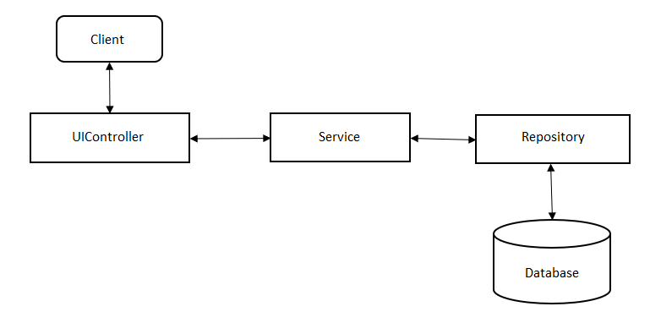
WORKING OF BACK-END

Slide 5
WORKING OF FRONT-END
EMS Website implements the MVC(Model-View-Control)Architecture. As View, Angular-8 with routing is used. For the backend, Spring Boot is used.
Java Persistence API (JPA) is used to write the Business Logic. REST Api’s are written to communicate between server ports (Angular->port:4200, SpringBoot ->port:8080, MySql -> port:3306)
The project consists of home page, when the user navigates to localhost:4200. After registering and logging in as a User and user can add, update, remove, view and search the employee details.

Slide 6
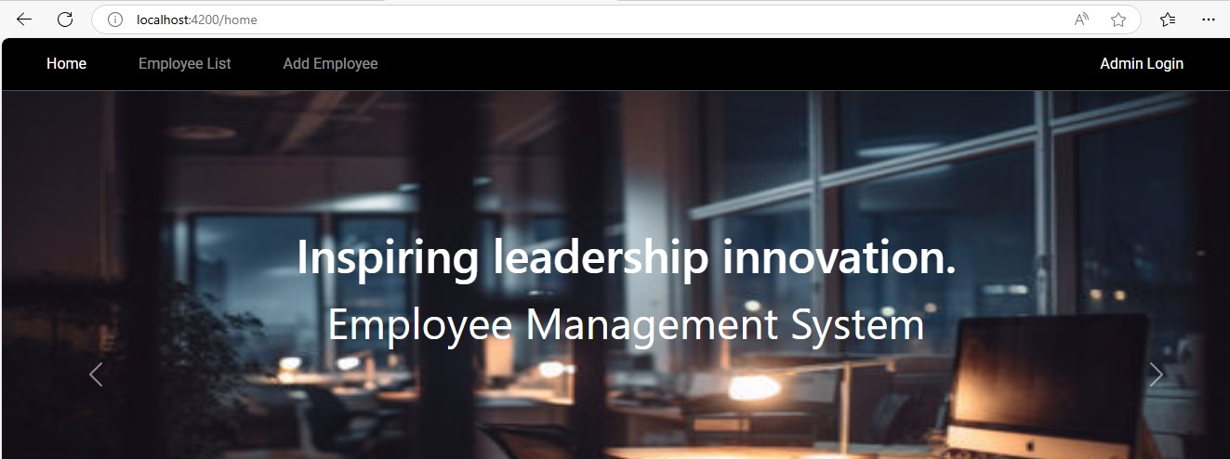
HOME PAGE

Slide 7
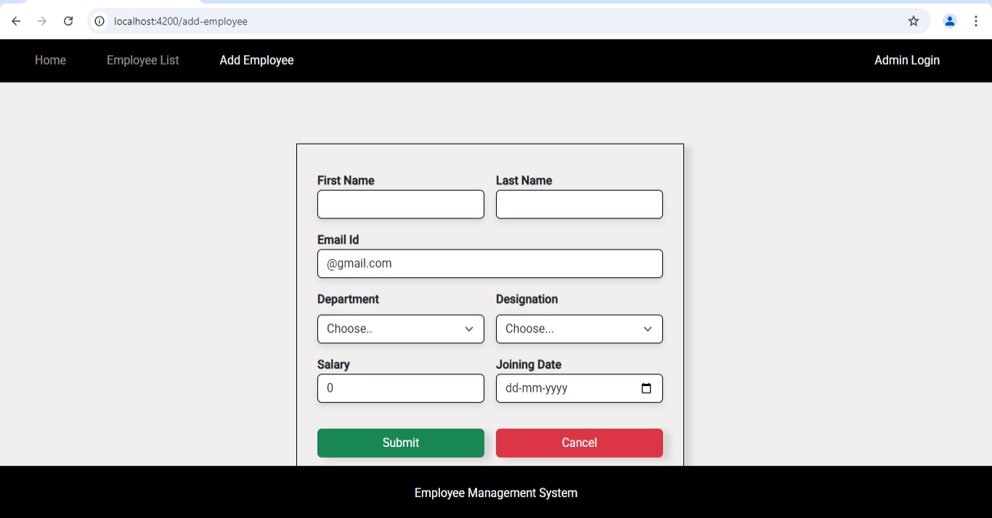
ADD EMPLOYEE

Slide 8
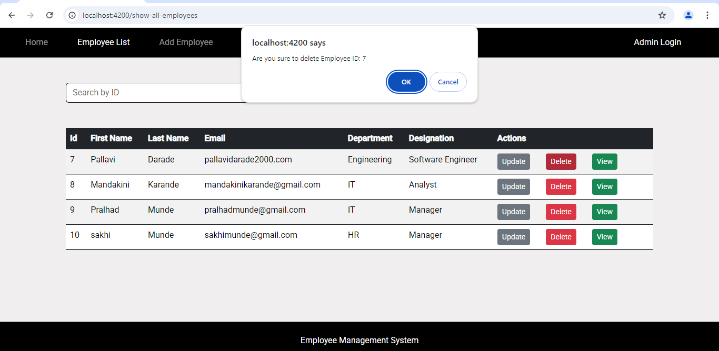
DELETE EMPLOYEE

Slide 9
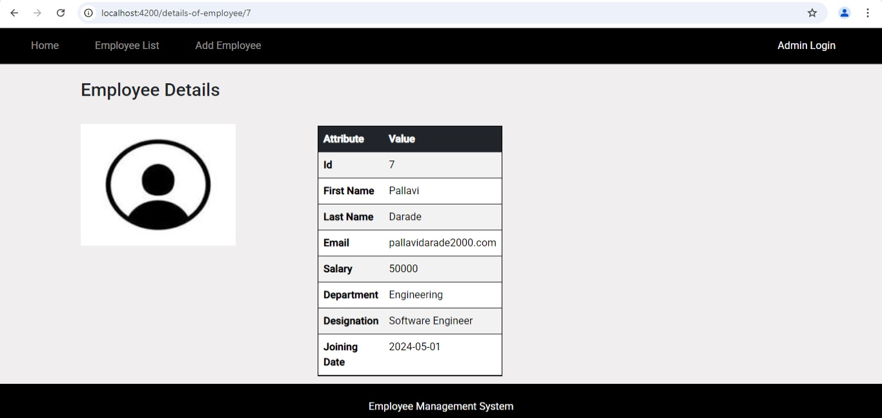
VIEW EMPLOYEE DETAILS

Slide 10
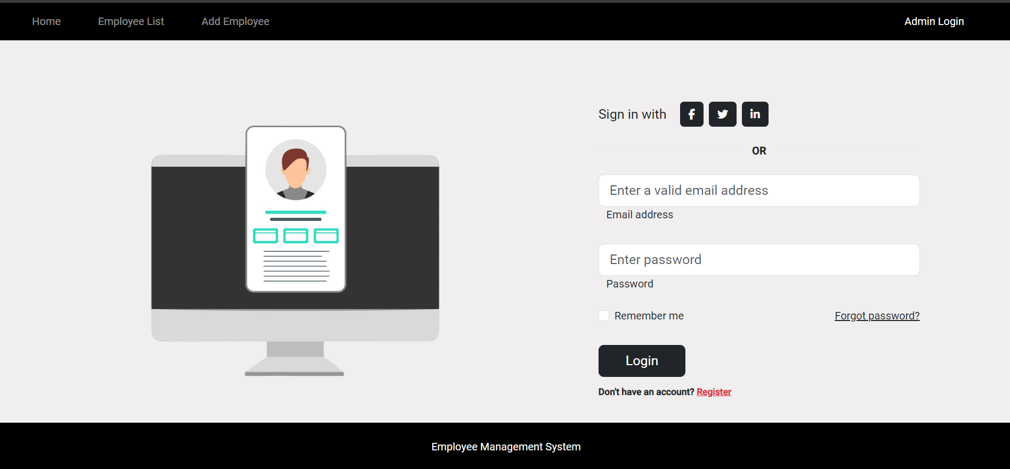
ADMIN LOGIN PAGE

Slide 11
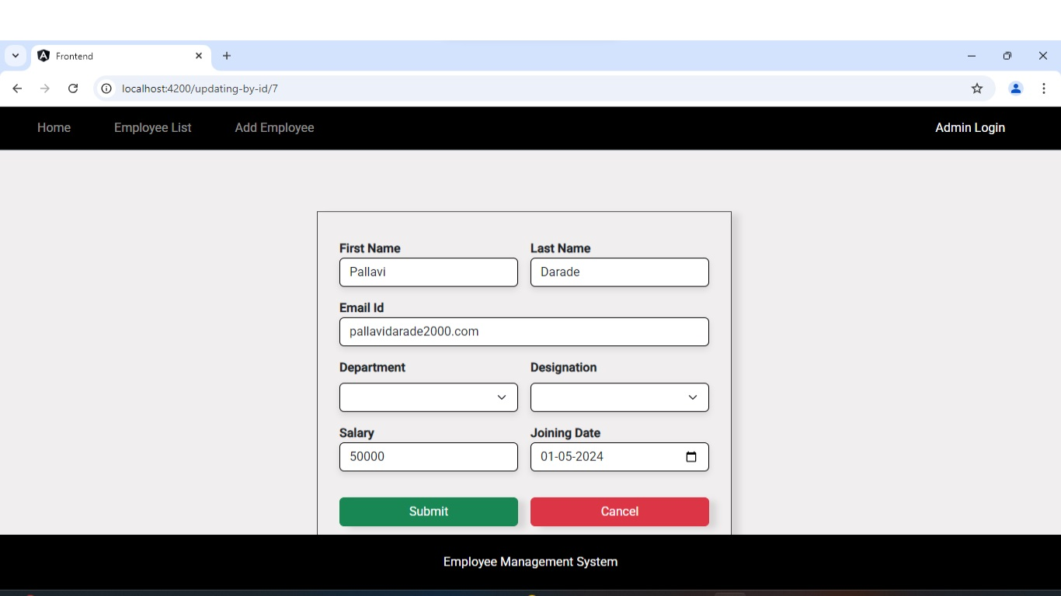
UPDATE EMPLOYEE

Slide 12
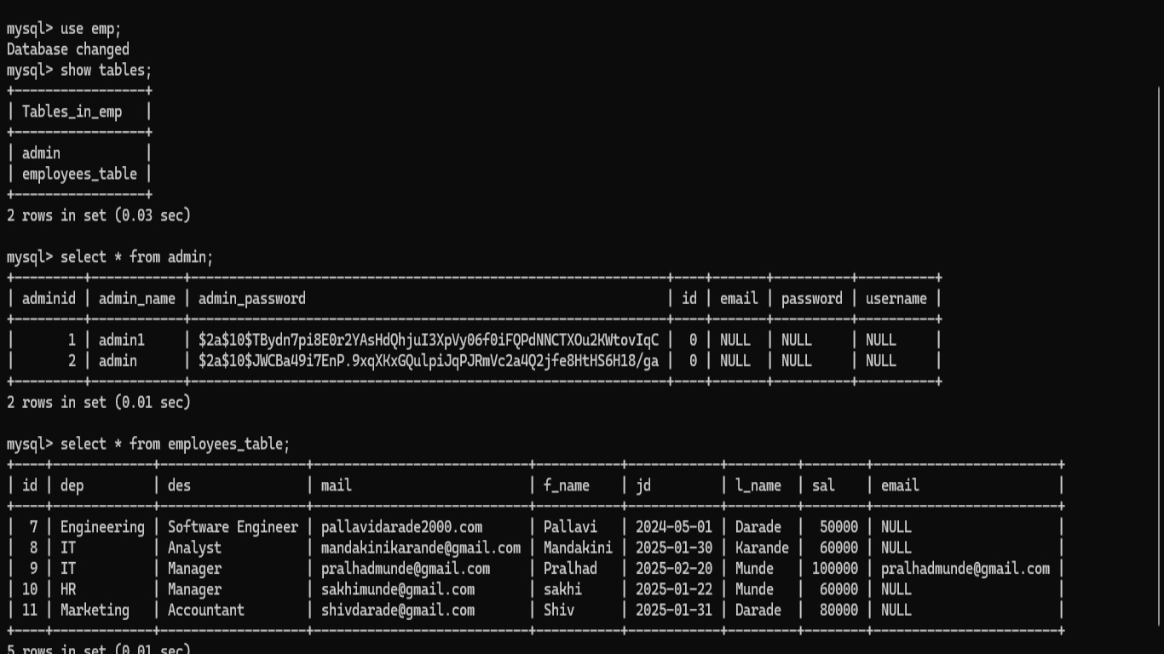
MYSQL DATABASE

Slide 13
ANNOTATIONS
Annotation is a form of metadata that provides data about a program.
Annotation starts with ‘@’.
@Id: This id annotation is used to declare the attribute as the primary key.
@GeneratedValue: Used to generate value automatically when the user inserts a new record in the table.
@Entity: Specifies that the class is an entity.​
@Column: Specifies the mapped column for a persistent property or field .If no column annotation is specified, the default values apply.
@Repository: Indicates the class provides the mechanism for storage, retrieval, search, update and delete operation.

Slide 14
ANNOTATIONS
​@PathVariable: Specifies the name of the path variable to bind to.
@RequestBody: ​used to deserialize the request body into an object.
@RestController: Used at the class level and allows the class to handle the requests made by the client.​
@Autowired: Used for automatic dependency injection.​
@CrossOrigin: Used to share resources from one domain to another.
@Service: Used to mark the class as a service provider
@Transactional: Marks the start and end of a transaction.

Slide 15
USER API’S
@GetMapping ("/list") – To fetch the user data from the table.
@GetMapping ("/list/{userId}") – To fetch the data using user ID.
@PostMapping ("/list") – To add user details in table.
@PutMapping ("/list") – To update the user details.
@DeleteMapping ("/list/{userId}") – To delete the user record based on user ID.

Slide 16
SOFTWARE REQUIREMENTS
OPERATING SYSTEM : WINDOWS 7 AND ABOVE
IDE : SPRING TOOL SUITE
CLIENT : POSTMAN
DATABASE : MY SQL
FRONT-END : ANGULAR

Slide 17
HARDWARE REQUIREMENTS
CPU : INTEL CORE 13 PROCESSOR
RAM : 4GB AND ABOVE
HARD DISK : 20GB HARD DISK SPACE

Slide 18
FEATURES:
Employee Profile Management: Create, read, update, and delete employee profiles with ease.
Role-Based Access Control: Assign roles to employees, ensuring secure access to sensitive data.
Search and Filter: Quickly find specific employee records using search and filter functionality.
User-Friendly Interface: Intuitive Angular-based UI provides a seamless user experience.

Slide 19
CONCLUSION
The Employee Management System developed using Angular and Spring Boot is a comprehensive and scalable solution for managing employee data. This project demonstrates the successful integration of frontend and backend technologies to create a user-friendly and efficient system.
Key Achievements:
Designed and implemented a robust database schema to store employee data
Developed a secure and scalable backend API using Spring Boot
Created a responsive and intuitive frontend interface using Angular
Implemented CRUD operations for employee data management

Slide 20
Thank you…

